Slide 1
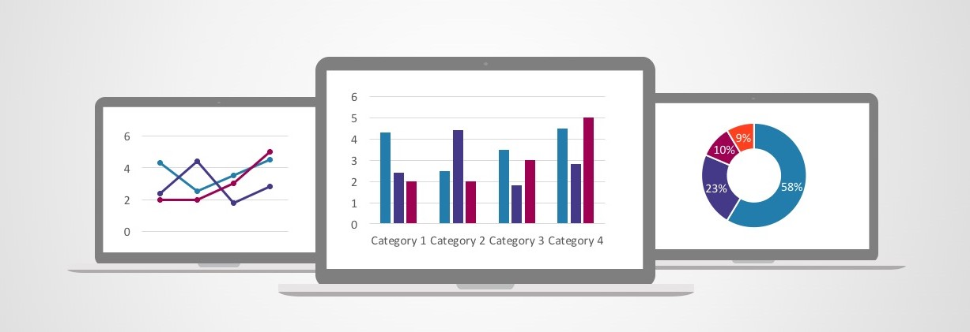
Graphing analysis
Presented by:
Vishal Naik

Slide 2
Structured data sent from Bigquery
Google cloud platform
Data is restructured according to
requirement
Output graph is obtained and
shown to user

Slide 3
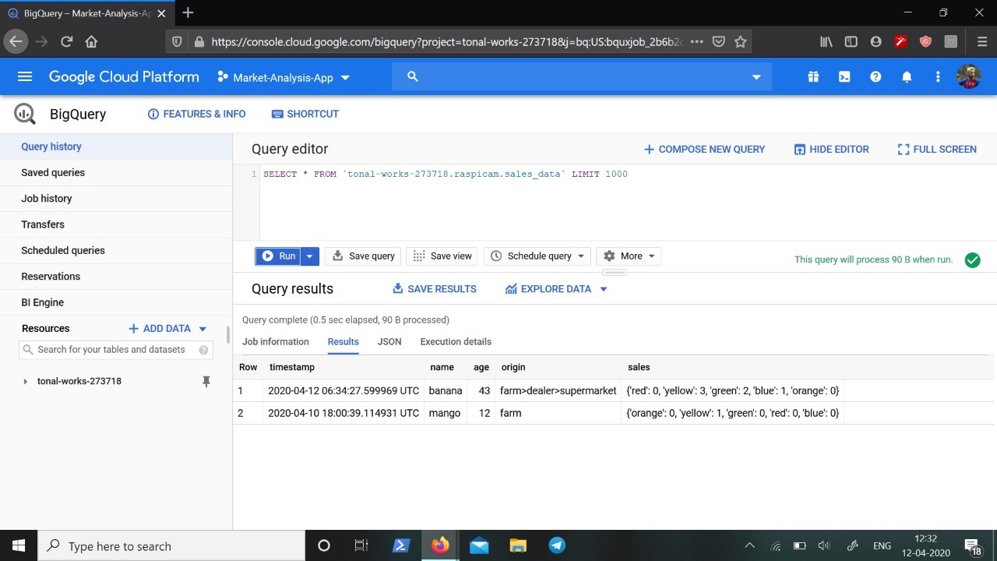
Data format in BigQuery((GCP)

Slide 4
Sample Data
data = [ [ '04/10/2020, 18:00:39' , 'mango', 43, 'farm', "{ 'orange' : 0, ' yellow ': 1, 'green': 0, 'red': 0, 'blue': 0}"] ,
['04/12/2020, 06:34:27', 'banana', 22, 'farm>dealer>supermarket', "{'red': 0, 'yellow': 3, 'green': 2, 'blue': 1, 'orange': 0}"] ]
get_plot(data)

Slide 5
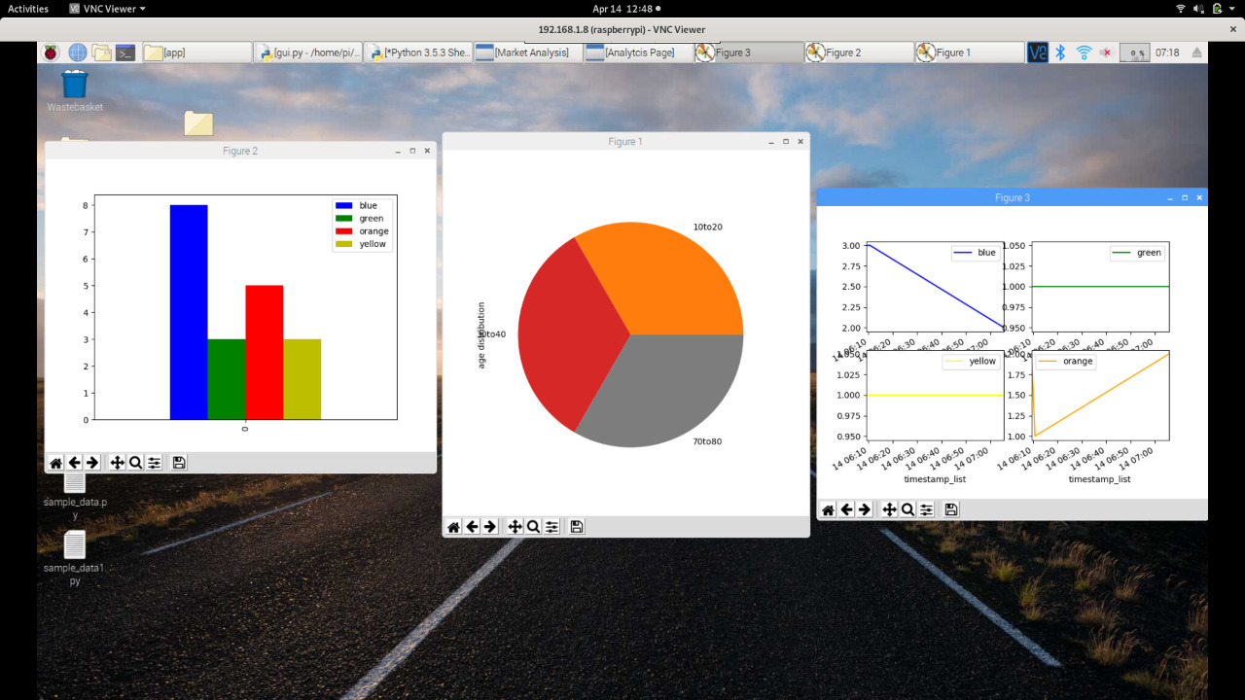

Slide 6
Python Modules Used:
import pandas as pd
import matplotlib.pyplot as plt
from datetime import datetime
from pandas.plotting import register_matplotlib_converters

Slide 7
Thank You

